Slide 1
Web Development 1
Athlone Institute of Technology – Karol Fitzgerald

Slide 2
My Details
Lecturer: Karol Fitzgerald
Room: Z304
Email: kfitzgerald@ait.ie

Slide 3
Presentation Contents
Aim of module
Learning Outcomes
Teaching/Learning Strategies
Syllabus/Practical Content
Module Assessment
Class Structure/Attendance
Important things to note

Slide 4
Aim of module
To introduce students to a variety of web technologies

Slide 5
Learning Outcomes
Create visually impressive HTML/XHTML documents
Apply a consistent style to your Web site using CSS (Cascading Style Sheets)
Write and in cooperate JavaScript code into webpages
Understand XML and generate Web content from XML using XSL
Write XML and XSL documents
Work as part of a team

Slide 6
Teaching/Learning Strategies
Lecture (Lecture/Practical)
Practical‘s
Independent Learning
Recommended 2 hours per week

Slide 7
Syllabus/Practical Content
Syllabus
Practical
Introduction
Internet Evolution, TCP/IP, IP addresses, DNS, URLs, Domain Names, Internet, Firewalls, Internet versus WWW
Maintaining good directory structure when working with files
CSS
Syntax, selectors, external style sheets
HTML5 & XHTML
JavaScript
Dynamics & Client-side execution, variables & types, statements, operators, control structures, input/output, functions, arrays etc.
Lab based PC exercises designed to correlate with progress on the course
Mini project designed to incorporate all of the skills acquired

Slide 8
Module Assessment
Web Development is 100% CA
Assessment may consist and include a combination of:
In class PC Bases Assessments
Moodle Quizzes (2 x 15%) 30%
PC Assessment 20%
Project 50%

Slide 9
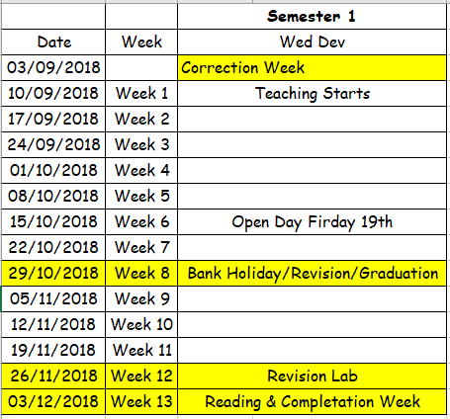
Semester 1 2018 - 2019

Slide 10
Class Structure/Attendance
Attendance will be recorded via Moodle at the start of every lab/lecture
Students arriving late. WILL NOT HAVE THEIR ATTENDANCE RECORDED
Recorded by
date of attendance
what was covered in Lab/Lecture
You will be able to check your own attendance
If the lab is open
Come in and get logged into your PC
Get working straight away, there will be Web Dev assignments/project work that you will always working on. Don’t wait for me.
Late arrivals disrupts class so please arrive on time

Slide 11
Important things to note
Maintain a good directory structure when constructing websites.
Keep a record of all lab solutions. This will prove extremely useful for revision, project work & portfolio.
Submit assignments/projects/portfolio on time
Get logged in and set-up at start of class
No Facebook/Social Networking during class
NO FOOD OR DRINK IN THE LABS
If you are having difficulty ASK

Slide 12
Remainder
Web Space – Portfolio & Project
USB stick – You will need one
Online storage
One Drive
Drop Box
Google Drive

Slide 13
Registering in your correct group on Moodle
Moodle Layout
You will now register in your correct group on Moodle
Open Google Chrome
Logon to elearning.ait.ie
Navigate to the Web Development 1 module.
This module will be used for both semester 1 and semester 2 notes, assignments, quizzes etc.
You will only have to do this once; unless you are deregistered
Follow the links until you are requested for an enrolment key which I will provide in a moment.
Once everyone has logged in I will go over the different sections of Moodle

